Slide 1
A Site for All Eyes – Considerations for Responsive Design October 19, 2012
Dori Kelner, MS
Principal, Sleight-of-Hand Studios
dmkelner@sohstudios.com
@dorikelner
Bill Killam, MA CHFP
President, User-Centered Design
bkilliam@user-centereddesign.com

Slide 2
August, 1981
Notes:
What does August 1981 have to do what interaction or user experience design?
August 1981 was the date of the introduction of the Xerox Star 8010 computer system with the Star user interface. At that moment, a revolution occurred in interaction/user experience design for computer interfaces.

Slide 3
Hardware/IDx from the Xerox 8010
Removable storage
The first local network
Bit mapped displays
Mouse
Windows
Icons
Menus
Desktop Metaphor
WYSIWYG
Direct Manipulation
Notes:
The Xerox 8010 system brought together many new (at the time) technologies including removable storage, local networking that allowed share resources like printers, the first bit mapped display, and the first mouse. Those technologies were used to introduce the world to a unique computer interface that employed windows, icons, menus, a pointing devices, direct manipulation, and the real world metaphor to create what we have come to know as a graphic user interface. And though many attempts have been made of the last 30 years to create a new interaction paradigm, the basic paradigm introduced by the Star UI has not changed significantly.

Slide 4
Technology Advances First
Notes:
But the designers of the Xerox Star UI had an advantage that modern user interaction/experience designers do not have - the technology and the user interface where developed together.
Today it is usually the case, and some (including Don Norman) argue that it is a necessary condition that technology must advance first, and interaction/user experience design is then forced to catch up. But we, the interaction/experience design experts, are still trying to catch up in many ways while technology continues to advance.

Slide 5
Client-servers and the Web
Windows
Mac
Web-based Application
Notes:
Consider the web itself. Slight differences exist in the interfaces for Windows and the Mac, but web-based applications are viewable on both platforms. Which standard do you follow? You put the OK and Cancel button in the Windows order or the Mac order? Do you use the rounded visual design of the Mac, the more square visual design, develop one of your own? How do these differences effect the user experience? Client/server apps update screens in a very different way then HTML. Change blindness is, therefore a common event on the web. (Ajax was supposed to address that, but how common is Ajax even today?

Slide 6
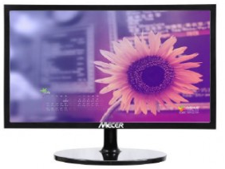
Displays
Notes:
Or consider the revolution of display technology. Coincident with the development of panel displays was the shift from an aspect ratio of 4:3 to an aspect ratio of 16:9, first introduced in 2003. That change, coupled with variations in screen size that had already been part of the design landscape, meant that interaction designers had to consider how to address multiple screen layouts for a single design. Debates over the use of fixed width designs versus liquid designs versus partially liquid have raged on for years. The fundamental question being: Do liquid design change the user experience? And even though they were introduced in 20093, few universal, de facto, of de jure standards exists for addressing this single issue.

Slide 7
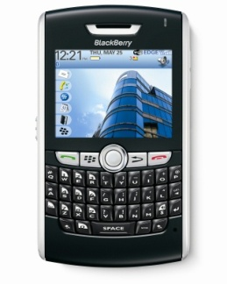
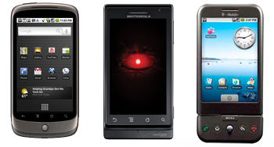
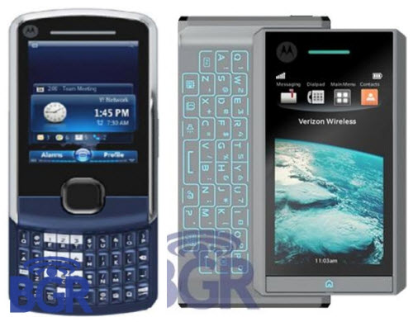
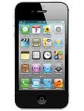
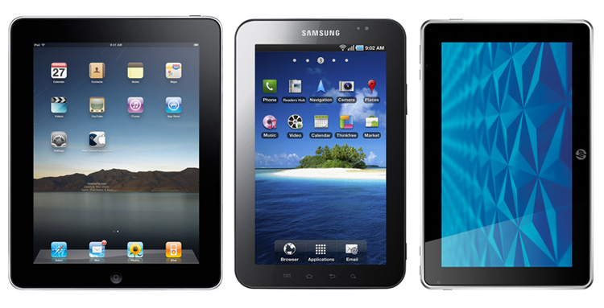
New Devices – New Challenges
Notes:
Fast forward just a few short years and we now have the a more significant technology change challenging the IDx/experience design world - the introduction of smart phones and tablets. Like the change from 4:3 to 16:9 aspect ratio, interaction designers have to deal with not 2 but many different aspect ratios. But unlike display screens on computers that vary in relative size, the variation screen sizes on smartphones and tablets are so significant to suggest an entirely new design on the display - not just a miniature version of what exists on a larger display. Smart phones and tablets have also introduced an entirely new set of interactive primitives. Keypads may still exist, but so has other input means. And the sequence control portion of the interface includes often device unique gestures in place of traditional GUI style point and click. Can we even an equivalent user experience across these uniquely different devices? Or do we create experiences that complement each other? And even though the user experience is what we are primarily interested in, we have to be cognizant of the issues of implementation. Do we create 15 different CodeBase is to accommodate the 15 different devices that are expected to be used? Or can we develop a single code base that can accommodate this differences. This requires us to understand and work more closely with the developers – a necessary condition of any project that is often not met.

Slide 8
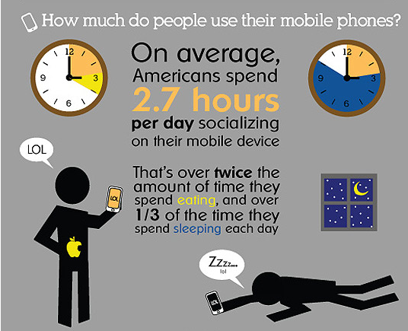
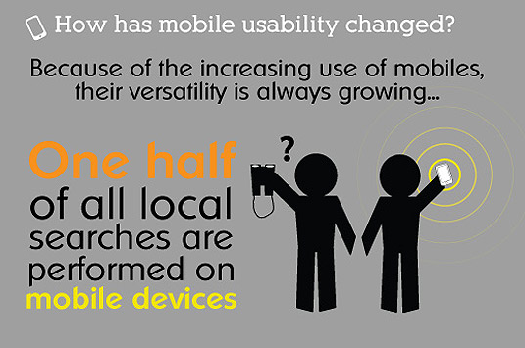
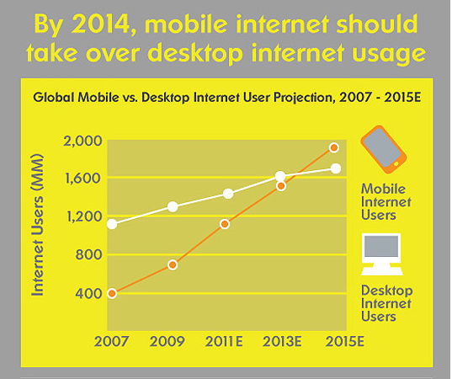
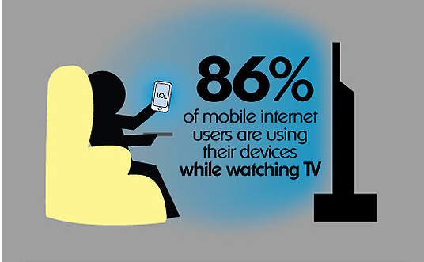
Should we care?
Notes:
But is this a market we really need to care about? Or care about today? Let’s consider some of the statistics. There are some nice infographics from the people at Smart Insight. Mobile devices of become so ubiquitous in our lives that the average American spends almost 3 hours a day just socializing on their device. Imagine the marketing potential there. Some statistic suggest that half of all internet searches are performed on mobile devices. And it’s projected that Internet usage on mobile devices should overtake Internet usage on desktops by 2013. And we use the device typically when we are doing other activities. So now, in addition to distracted driving, as interaction designers we have to turn that around and consider the issue of distracted browsing – a challenge for ease-of-use of learning and eae-of-use issues in our designs.

Slide 9
What do we do?
Notes:
So the questions we should be asking ourselves include: Can we create an equivalent user experience across these uniquely different devices? Is that even possible given the differences? Or do we create experiences that complement each other? And even though the user experience is what we are primarily interested in, we have to be cognizant of the issues of implementation. Do we create 15 different code bases is to accommodate the 15 different devices that are expected to be used? Or can we develop a single code base that can accommodate this differences. If we are to address these issues, we need to understand and work more closely with the developers – a necessary condition of any project that is often not met. So, let’s now look at the technology associated with multiple devices and the concept of adaptive design.

Slide 10
Tablet
iOS
Touch
B&W
Smartphone
Color
WebOS
Keyboard
TV
Android
Pixel density
Inflight
Blackberry
Orientation
Gaming
Appliances
Other
“Responsive design is the real deal. It is not a fad. It’s a legitimate attempt to address the massive challenge of delivering great experiences to this explosion of devices and browsers. But don’t feel like it’s the end-all be-all of website construction. This ain’t religion. This is web design.”
Brad Frost
Notes:
responsive design isn’t the goal, a device-agnostic web is. Does it enhance the goal of the user experience?
design and development should respond to the user’s behavior and environment based on screen size, platform and orientation.

Slide 11
Overview
Framework: fluid grid, media queries, flexible images
Behavioral issues: design for the user
Typography: size matters
Process: rethinking how we work
Performance: you need to hear this
Notes:
The practice consists of a mix of fluid grids and layouts, images and an intelligent use of CSS media queries.
As the user switches from their device, the website should automatically switch to accommodate for resolution, image size and scripting abilities.
In other words, the website should have the technology to automatically respond to the user’s preferences.
This would eliminate the need for a different design and development phase for each new gadget on the market.

Slide 12
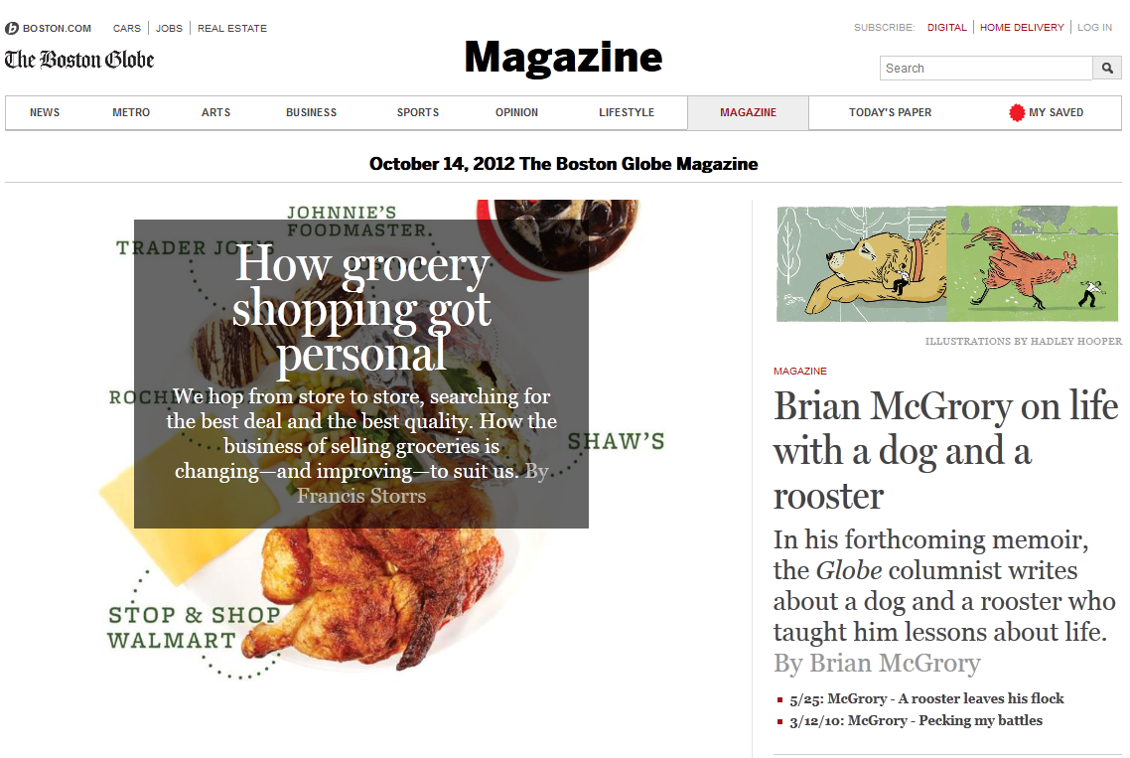
960px
.col-a
.col-b
634px
306px
.col-a {width: 66.0416666%} /* 634 / 960 */
.col-b {width: 31.875%} /* 306 / 960 */
Notes:
Fluid grid is designed in terms of proportions. Whether on a phone or wide screen the layout elements will resize their widths in relation to one another.
Implement in CSS.
Don’t round.
Margins and padding

Slide 13
1050px
810px
620px
480px
Notes:
Media queries allow you to gather data about the site visitor and use it to conditionally apply CSS styles
Ideal - adjust your layout to perfectly match every device width
Practical -When deciding what resolutions to target, you should use your judgment. Targeting more resolutions is going to take more time, and assuming you’re not an immortal being with unlimited time, that effort should be spent carefully.
Breakpoints should be device agnostic – let the content dictate where your breakpoints occur, and how many of them you need.
By allowing the content to guide you, you’re further decoupling your layout from a specific resolution. You’re letting the flow of the page dictate when the layout needs adjusting—a wise and future-friendly move.
Start resizing your browser window and see where there’s room for improvement. Begin with mobile and then slowly bring up the size of the window until things start to look like they need a touch up.

Slide 14
August 29, 2012
first draft of official specification from W3C for RESPONSIVE IMAGES
Respond to different screen pixel width/height in HTML
Respond to different screen pixel densities
Respond to users zooming in on images
Provide user agents with the information they need to select the most appropriate image source in low-bandwidth situations, via media queries (not yet available)
Preserve separation of content markup and styling
Provide a purely client-side solution that can include JavaScript, but doesn't require it
Provide different crops of an image according to the viewport or device through which it is viewed
Courtesy: Anselm Hannemann, .net Magazine
Notes:
Screen resolution – now you can’t rely on smaller screens being lower res
Bandwidth
Browser window width
There are still a lot of tricks and hacks
Adaptive Images by Matt Wilcox
Using SVG graphics today, by Josh Emerson
Resolution independence with SVG, by David Bushell
Using CSS sprites to optimize your website for Retina displays, by Maykel Loomans
Flowchart: how to retinafy your website, by Thomas Fuchs
Symbolset icon fonts, by Oak Studios

Slide 15
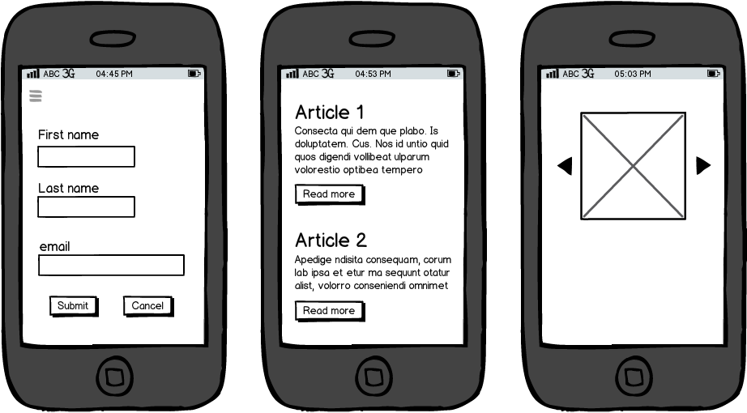
Behavioral Issues
Forms
Buttons
Gestures
Notes:
Think about the user experience on the smaller form factors.

Slide 16
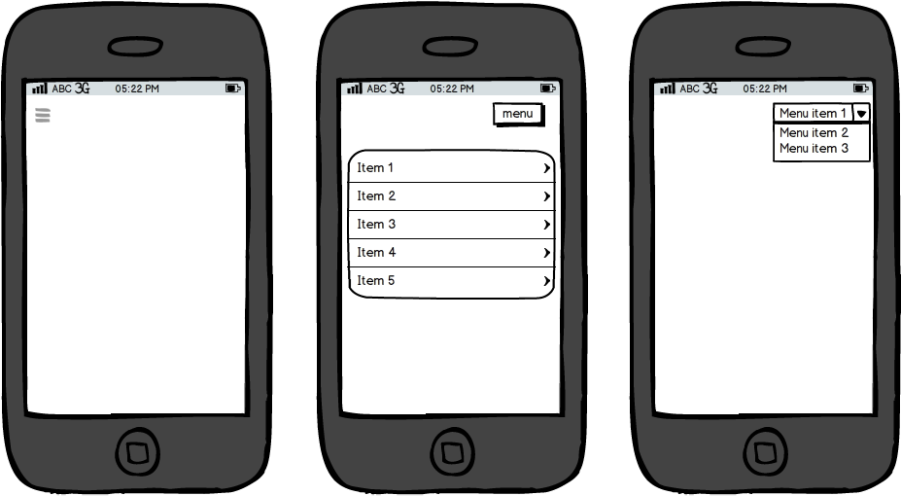
Menus
Flyout or Toggle
Select List
Dropdown
Notes:
Be aware of space and usability

Slide 17
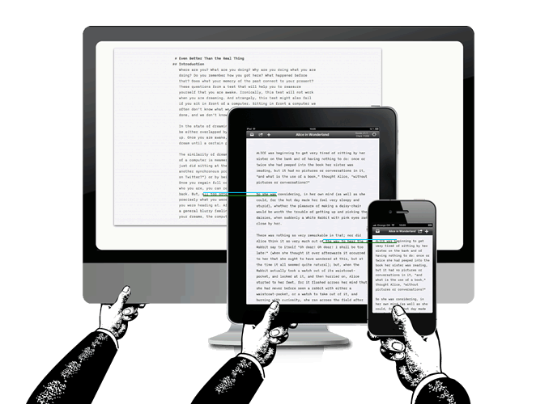
Responsive Typography
image courtesy: Oliver Reichenstein, iA
Notes:
The further away the smaller the type appears
Average perceived size – distance from screen to eye informs both design and typography
Increased distance – increase font size and line height
Ems or Rems (relative to body tag instead of context) ?? – not supported in IE8 and lower
Be careful about line length and breakpoints – go with reading feel

Slide 18
A Viable Process
Notes:
Need to update our process – make it viable – can’t throw the design over the fence
More flexible, iterative design and development cycle
Start with content strategy, build from mobile resolutions up. Let the content inform the site.
Mobile first, content first – simplify content and design before suppressing – this is foundational work – forces you to focus

Slide 19
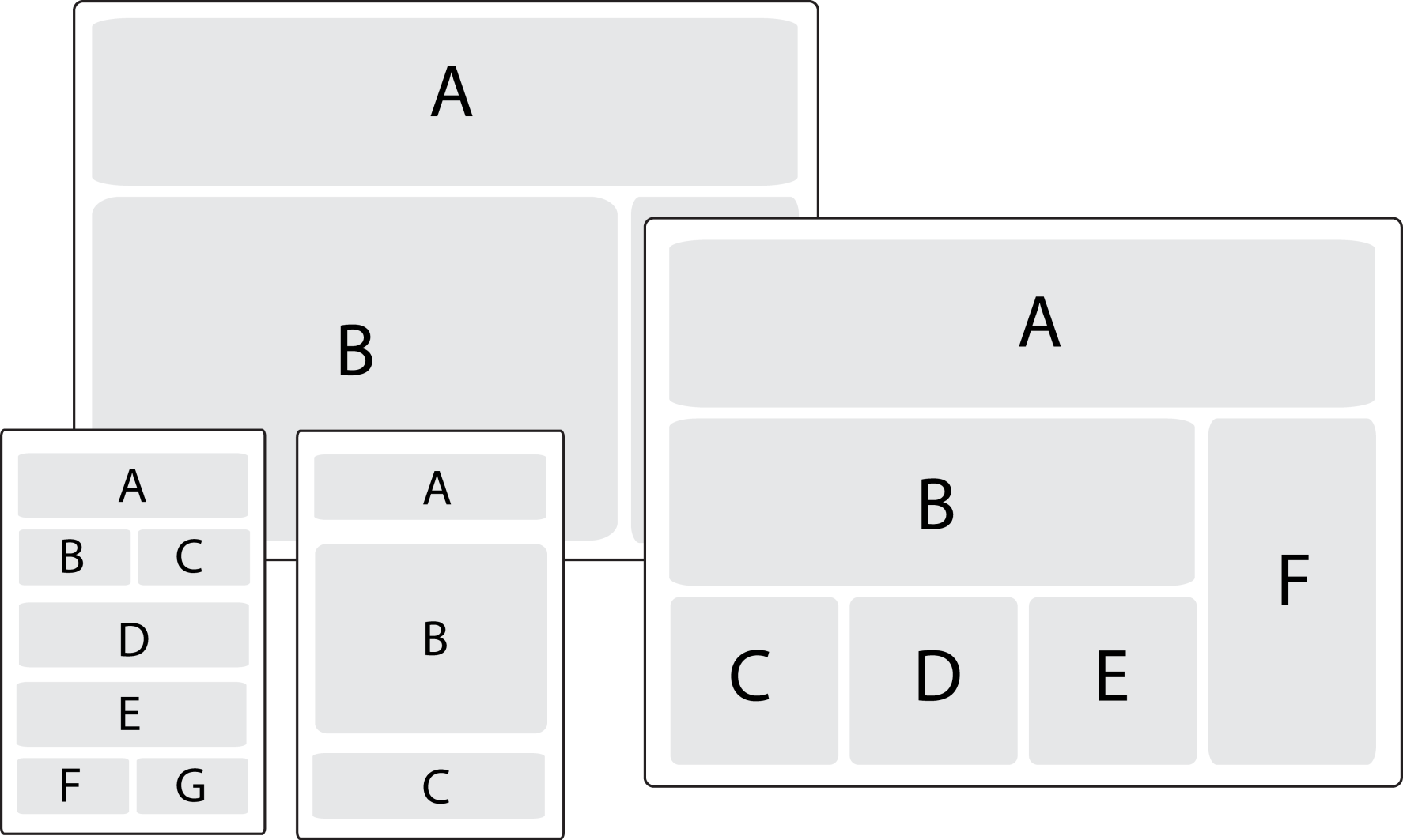
Responsive layouts, responsively wireframed
courtesy: James Mellers, Adobe
Notes:
Move away from photoshop quickly – need to design in the browser and need Hi fidelity Prototype in HTML5/CSS3/JS environment
Create wireframes in the browser that show how sections of the site will reposition

Slide 20
Performance
Users will only wait 2-3 seconds to load your page
display: none; only hides content (bad) but doesn’t lighten the page
Images account for a large proportion of the page load
Designers must know performance implications
Notes:
Must bring performance into design. Design has performance implications.
there is a disconnect: most people agree it’s important, but there is a dread of actually dealing with it.
Cycle the process between design & development - compromises between visual design and technology from the very beginning
Progressive enhancement – build from smallest up – conditional loading of CSS and scripts, lighter HTML, feature detection
Device testing in contract.

Slide 21
Wrap it Up
Our goal is a device agnostic web
Design for user experience
Start with content strategy
Mobile first → progressive enhancement
Iterative design/development in the browser
Baked in performance
Notes:
Not magic, easy, or cheap
Requires a new strategy and process
Give serious attention to measuring performance

Slide 22
Resources
http://responsive.is
http://www.responsinator.com/
http://bradfrost.github.com/this-is-responsive/resources.html
http://www.alistapart.com/articles/responsive-web-design
http://www.netmagazine.com/features/top-responsive-web-design-problems-and-how-avoid-them
http://bradfrostweb.com/blog/web/responsive-nav-patterns/
http://www.netmagazine.com/features/ road-responsive-images
http://www.protytype.com/
http://informationarchitects.net/blog/ responsive-typography-the-basics/
http://blog.typekit.com/2011/11/09/ type-study-sizing-the-legible-letter/
http://www.guypo.com/mobile/performance-implications-of-responsive-design-book-contribution/
Dori Kelner, MS
Principal, Sleight-of-Hand Studios
dmkelner@sohstudios.com
@dorikelner
Bill Killam, MA CHFP
President, User-Centered Design
bkilliam@user-centereddesign.com

