Slide 1
An Introduction to Usability Testing
Bill Killam, MA CHFP
Adjunct Professor
University of Maryland
bkillam@user-centereddesign.com

Slide 2
Background

Slide 3
Definitions
“Usability testing” is the common name for multiple forms both user and non-user based system evaluation focused on a specific aspect of the design
Done for many, many years prior, but popularized in the media by Jakob Neilson in the 1990’s

Slide 4
Usability Defined
Accessibility
A precursor to usability: if users cannot gain access to the product, its usability is a moot point
Functional Suitability
Does the product contain the functionality required by the user?
Functional Discoverability
Can the user “discover” the functions of a product?
Ease-of-learning
Can the user figure out how to exercise the functionality provided?
Ease-of-use
Can the user exercise the functionality accurately and efficiently once its learned (includes accessibility issues)?
Can users use it safely?
Ease-of-recall
Can the knowledge of operation be easily maintained over time?
Safety
Can the user operate the system in relative safety, and recover from errors?
Subjective Preference
Do user’s like using it?

Slide 5
What does “usability” mean?
ISO 9126
“A set of attributes that bear on the effort needed for use, and on the individual assessment of such use, by a stated or implied set of users”
ISO 9241
“Extent to which a product can be used by specified users to achieve specified goals with effectiveness, efficiency and satisfaction in a specified context of use.”

Slide 6
What does “usability” mean? (concluded)
Jakob Neilson
Satisfaction
Efficiency
Learnability
Low Errors
Memorability
Ben Shneiderman
Ease of learning
Speed of task completion
Low error rate
Retention of knowledge over time
User satisfaction

Slide 7
Usability Testing is…
Any of a number of methodologies used to try to determine how a product’s design contributes or hinders its use when used by the intended users to perform the intend tasks in the intended environment
Most common forms include
Modeling & analysis
Expert Review/Heuristic Evaluations
User-based testing

Slide 8
When is usability assessed?
On an existing product to determine if usability problems exist
During the design phase of a product
During the development phase of a product to assess proposed changes
Once a design is completed to determine if goals were met

Slide 9
Methods

Slide 10
Types of Usability Testing
Modeling & Analysis
Link Analysis
Time Line Analysis
GOMS Modeling
Non-User Based Testing
Compliance Reviews
Expert Reviews (a.k.a. Heuristic Evaluations)
Cognitive Walkthrough
Pluralistic Walkthroughs

Slide 11
Types of Usability Testing (concluded)
User-based Testing
User Surveys/Questionnaires
Interviews
“Contextual Inquiry” (Field Observation)
Think Aloud Protocol
Interrupted-task Based Protocol
Co-Discover Protocol
Performance-based Protocol

Slide 12
Non-User Based Testing
12

Slide 13
Compliance Testing
Possible (within limits) to be performed by anyone
Can remove the low level usability issues that often mask more significant usability issues

Slide 14
Compliance Testing (concluded)
Style Guide-based Testing
Checklists
Interpretation Issues
Scope Limitations
Available Standards
Commercially GUI & Web Standards and Style Guides
Domain Specific GUI & Web Standards and Style Guides
Internal Standards and Style Guides
Interface Specification Testing
May revert to user acceptance testing

Slide 15
Pluralistic Walkthrough
Team Approach
Best if a diverse population of reviewers
Issues related to cognition (understanding) more than presentation
Also low cost usability testing
Highly dependent on the qualifications of the reviewer(s)

Slide 16
Cognitive Walkthrough
Specific review to ensure the correct information is available for the task being performed
Also low cost usability testing
Highly dependent on the qualifications of the reviewer(s)

Slide 17
Expert Review
Aka: Heuristic Evaluation
One or more usability experts review a product, application, etc.
Free format review or structured review
Subjective but based on sound usability and design principles
Highly dependent on the qualifications of the reviewer(s)

Slide 18
Expert Review (Concluded)
Nielson’s 10 Most Common Mistakes Made by Web Developers (three versions)
Shneiderman’s 8 Golden Rules
Constantine & Lockwood Heuristics
Forrester Group Heuristics
Norman’s 4 Principles of Usability

Slide 19
1st Heuristic
Functional discoverability through obvious interactive elements and adequate feedback
19

Slide 20
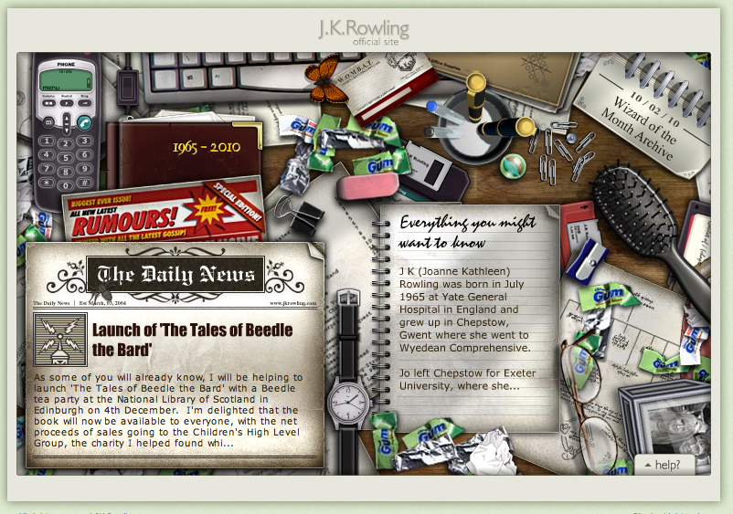

Slide 22
2nd Heuristic
A good, complete, and unambiguous cognitive (or conceptual) model to predict the effects of our actions
22

Slide 27
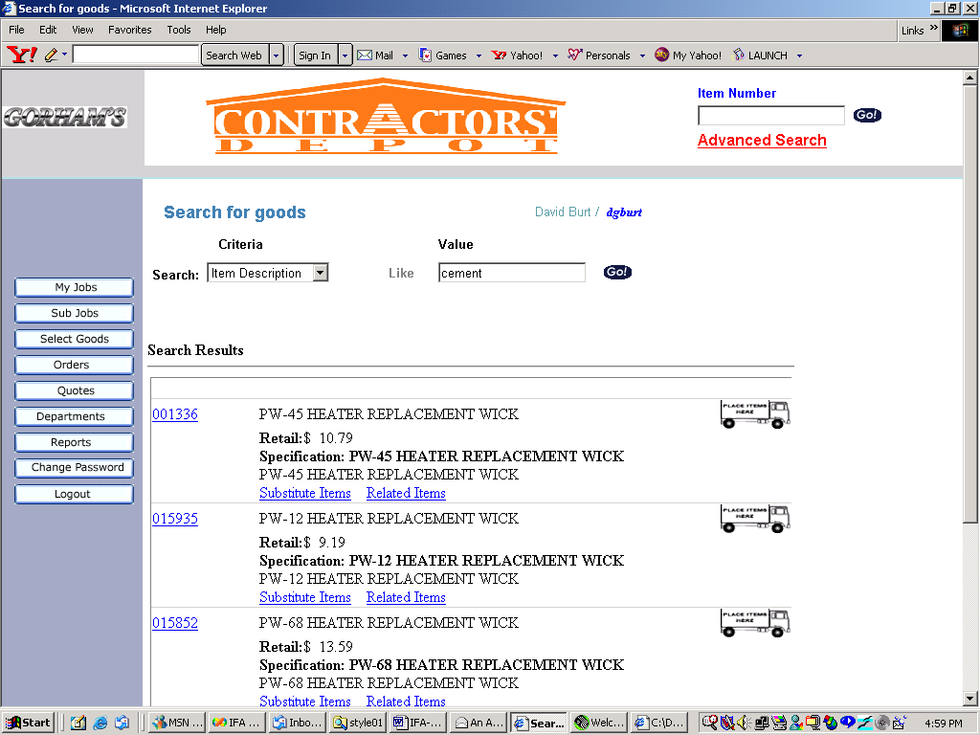
Cognitive Models
We all develop cognitive models
They may not be complete
They may be inconsistent
They ay be self contradicting
They are not always correct
We don’t necessarily invest in maintaining our cognitive models

Slide 28
Cognitive Model Issues

Slide 29
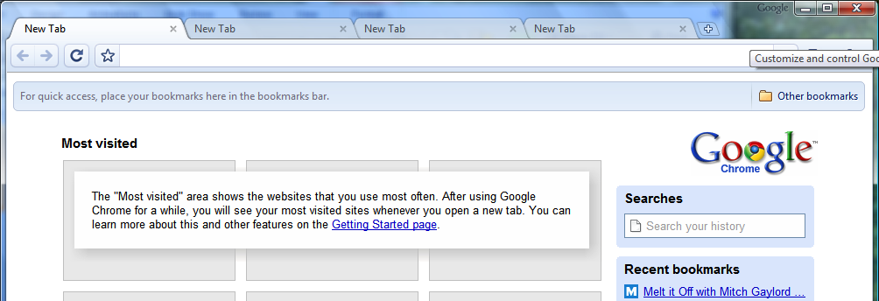
Conceptual Model Issues

Slide 30
3rd Heuristic
Design for the intended users (and not yourself)

Slide 33
 | 1131 | SAN | 0820+1 | LGW | AA | 2734 | FCYBM | D10 | 1
 |  | AA | 2734 | CHG PLANE AT DFW
X12 | 1805 | SAN | 1425+1 | LGW | BA | 284 | FJMSB | D10 | 1
 | 2100 | SAN | 2030+1 | LHR | TW | 702 | FCYBQ | * | 2
 |  | TW | 702 | EQUIPMENT 767 LAX L-10

Slide 35
4th Heuristic
Design for Errors (Slips)
35

Slide 36
Error versus Slip
Errors are generated by a lack of understanding or a lack of sufficient or correct information
Lack of sufficient or correct information is the responsibility of the designer in the presentation layer of an interface
Lack of understanding is the responsibility of the designer in interaction and in conceptual model of an interface
Errors are often undetectable by the end user
Examples: Refrigerator, Ollie North
Slips are common users issues
Hand/eye coordination or basic control of our psychomotor systems
Exacerbated by distraction, speed, attention overload
Unavoidable by design but need to be anticipated and addressed by the designer

Slide 37
User Based Testing
37

Slide 38
Statistics: A Primer
38

Slide 39
Why Statistics?
Testing is used to support a decision
For example, “this design change is going to be better for users”, or “design A is better than design B”
Research to used to test a hypothesis based on a theory
Smoking increases the likelihood of developing cancer
Usability testing is generally done with small samples (mostly do to the cost associated with any alternatives)
Statistics are used to provide a way relate the small sample tested to the larger population
All statistical analysis assumes the data obtained is valid and reliable
39
User-Centered Design • www.user-centereddesign.com
Notes:
39

Slide 40
Validity
Validity is the degree to which the results of a research study provide trustworthy information about the truth or falsity of the hypothesis*
Internal validity refers to the situation where the “experimental treatments make a difference in this specific experimental instance” (from Cambell, D.T. & Stanley, J.C. (1963) Experimental and Quasi-experimental Designs for Research
External validity asks the question of “generalizability”
*Cherulnik, P.D. 2001. Methods for Behavioural Research: A Systematic Approach
40
User-Centered Design • www.user-centereddesign.com
Notes:
40

Slide 41
Reliability
Reliability is the ability of a test to show the same results if conducted multiple times
Test-retest reliability
Repeatability
Reproducibility
41
User-Centered Design • www.user-centereddesign.com
Notes:
41

Slide 42
Humans are complex processing systems, dynamic and highly affected by context, and all different
42

Slide 43
Perceptual issues (our brain’s versus our senses)…
43

Slide 44
+ •

Slide 45
+

Slide 50
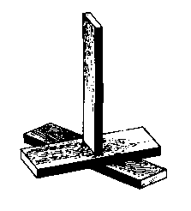
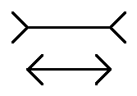
Müller-Lyer Illusion

Slide 51
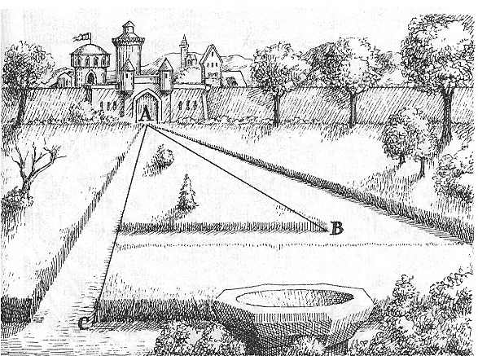

Slide 52
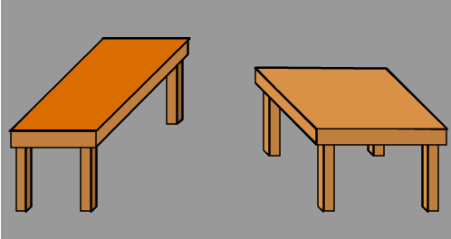

Slide 55
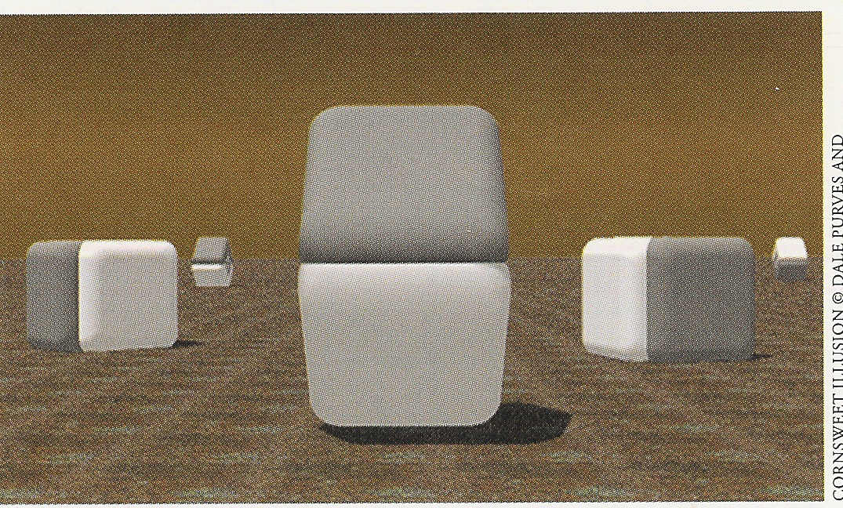

Slide 58
The Gestalt Principles
58

Slide 59
Proximity

Slide 60
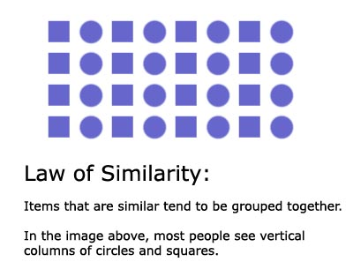
Similarity

Slide 61
Parallelism (Similarity)
Elements that are parallel to each other appear more related than elements not parallel to each other.

Slide 62
Symmetry
The idea that when we perceive objects we tend to perceive them as symmetrical shapes that form around their center (competes with proximity).

Slide 63
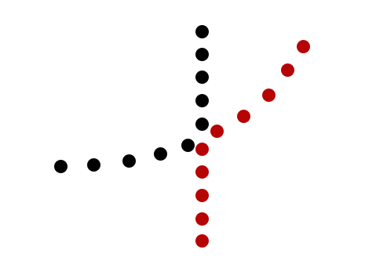
Continuation

Slide 64
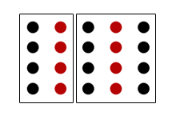
Common Region
Elements tend to be grouped together if they are located within the same closed region.

Slide 65
Prägnanz (German for “pithiness”)

Slide 66
Common Fate (Synchrony)
Elements moving in the same direction are perceived as being more related than elements that are stationary or that move in different directions. Elements that change at the same time group together.

Slide 67
Unity

Slide 68
Emergence
Emergence is the process of complex pattern formation from simpler rules

Slide 69
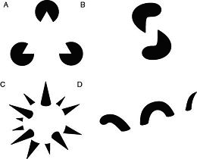
Reification
the constructive or generative aspect of perception

Slide 70
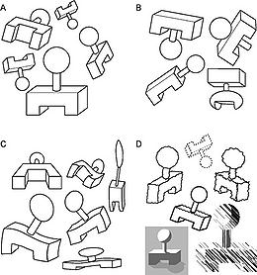
Invariance
simple geometrical objects are recognized independent of rotation, translation, and scale

Slide 71
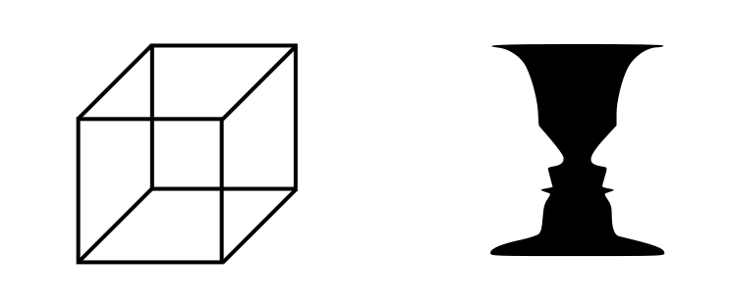
Multistability
the tendency of ambiguous perceptual experiences to pop back and forth unstably between two or more alternative interpretations
Necker Cube
Rubin Cube

Slide 72
Closure

Slide 74
:-)
:-(
;-)
8-)

Slide 75
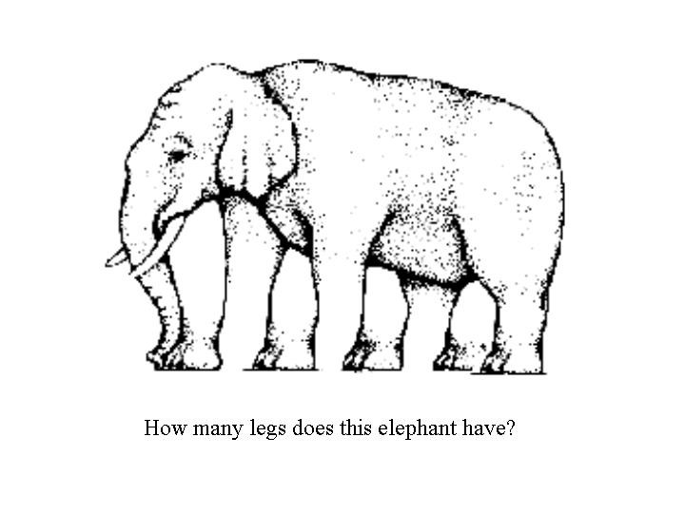

Slide 76
Closure Example 2

Slide 77
Closure Example 3

Slide 78
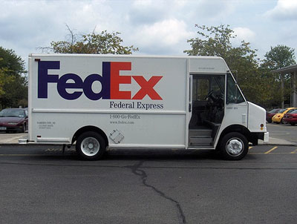
Closure Example 4

Slide 79
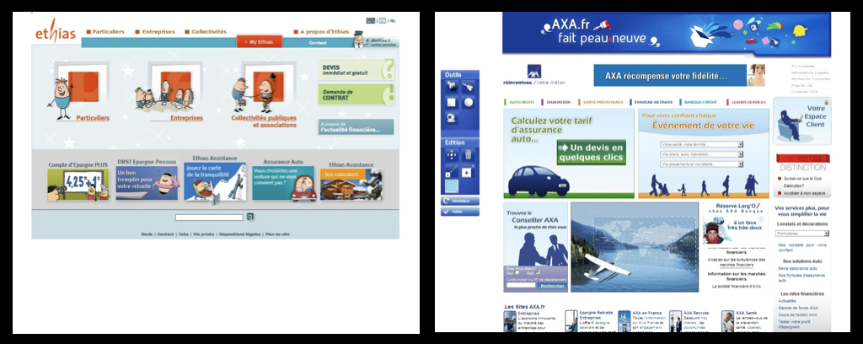

Slide 80
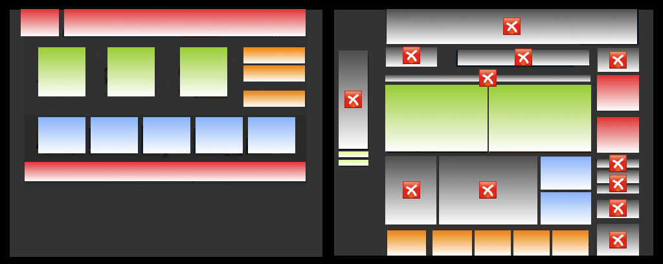

Slide 81
…our perceptual abilities are limited in the presence of noise…
81

Slide 82
THE QUICK BROWN FOX JUMPED OVER THE LAZY DOG’S BACK.
82

Slide 83
THE QUICK BROWN FOX JUMPED OVER THE LAZY DOG’S BACK.
83

Slide 84
THE QUICK BROWN FOX JUMPED OVER THE LAZY DOG’S BACK.
84

Slide 85
The quick brown fox jumped over the lazy dog’s back.
85

Slide 86
…our presumptions effects what and how we interpret things…
86

Slide 87
Jack and Jill went
went up the
Hill to fetch a
a pail of milk

Slide 88
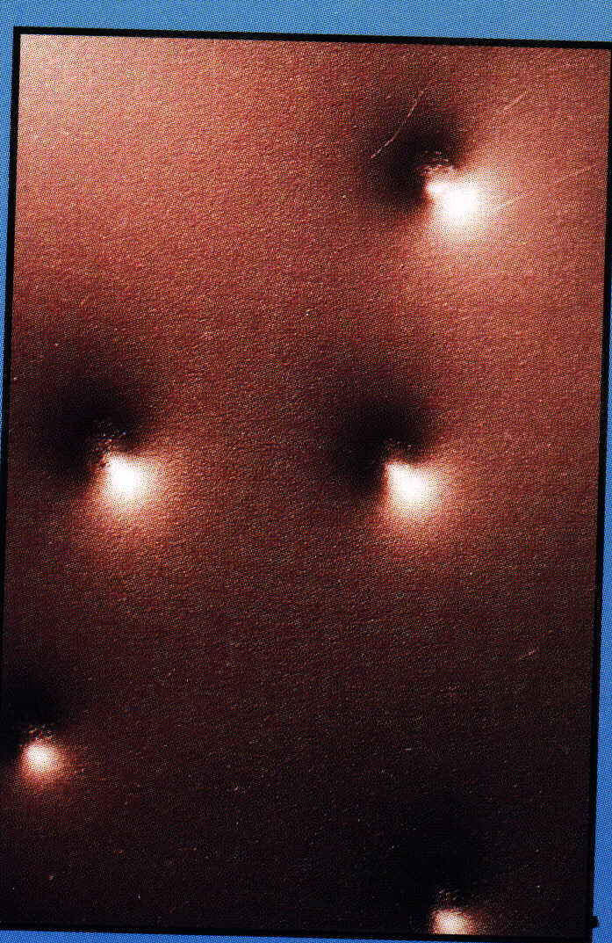

Slide 89
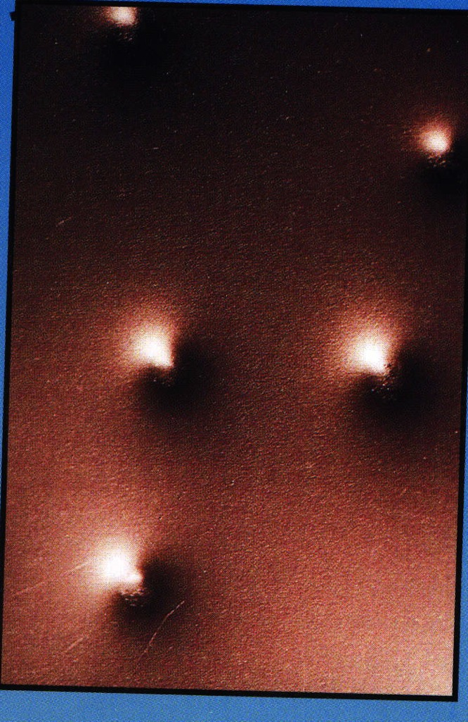

Slide 90
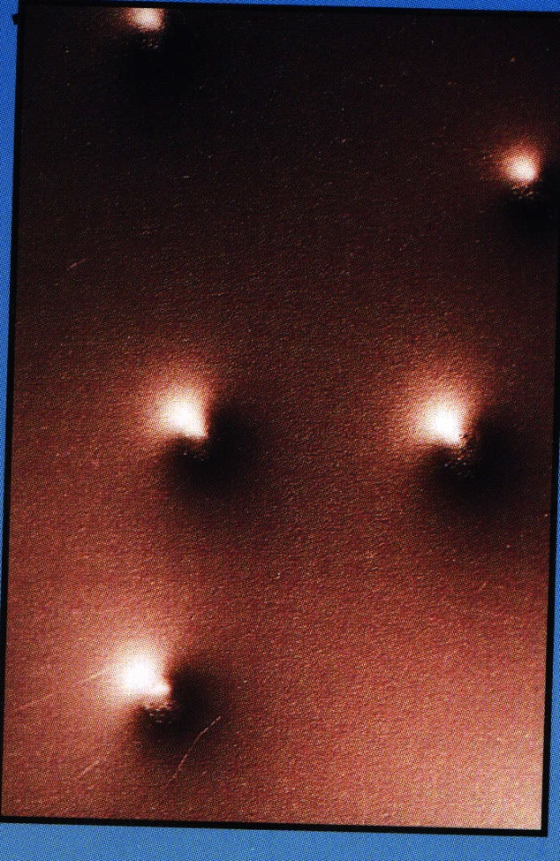

Slide 93
…our attention and cognitive abilities are limited, easily manipulated, and specialized…
93

Slide 94
FINISHED FILES ARE THE RE-
SULT OF YEARS OF SCIENTIF-
IC STUDY COMBINED WITH THE
EXPERIENCE OF MANY YEARS

Slide 96
Red
Green
Blue
Orange
Yellow
Black

Slide 97
Stroop
Stroop
Stroop
Stroop
Stroop
Stroop

Slide 98
Orange
Yellow
Green
Black
Blue
Red

Slide 99
Test Your Attention

Slide 100
Change Blindness
(The Person Swap Experiment)

Slide 101
Test your skill

Slide 102
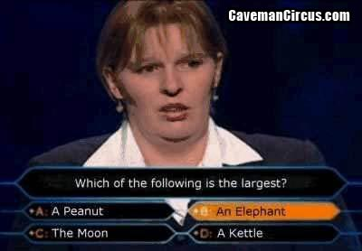
…our psychological state (e.g., anxiety) affects our performance…
102

Slide 103
Use of Confidence Intervals
When working with small samples, confidence interval provide a way to represent uncertainty in test results
Since each sample and each test is different, the confidence level tells the informed reader the likelihood that another sample will provide the same results. (In other words, if you ran the test again, what value are you likely to get next time?)
Typical confidence intervals in research include the 90% or 95% confidence interval. Behavioural research often uses a 80% confidence interval.
103
User-Centered Design • www.user-centereddesign.com
Notes:
103

Slide 104
Use of Confidence Intervals (continued)
“You just finished a usability test. You had 5 participants attempt a task in a new version of your software. All 5 out of 5 participants completed the task. You rush excitedly to tell your manager the results so you can communicate this success to the development team. Your manager asks, ‘OK, this is great with 5 users, but what are the chances that 50 or 1000 will have a 100% completion rate?’ ”- Jeff Sauro
The confidence level tells the informed reader the likelihood that another sample will provide the same results. In other words, if you ran the test again, what value are you likely to get next time?
104
User-Centered Design • www.user-centereddesign.com
Notes:
104

Slide 105
Use of Confidence Intervals (concluded)‏
Confidence intervals when testing with 8 people range from 37% (0 out of 8 or 8 out of 8) to between 50%-70% (all other values)
For example, if 6 out of 8 people successfully completed a task in your test, you can only predict that somewhere between 20% and 97% of all people would complete the task (assuming all conditions of validity and reliability have been met)
If you want to confidently state, based on your testing, that 9 out of 10 people will be able to successfully complete a task, and all conditions of validity and reliability have been met, you need to test 430 people and 400 of them have to successfully complete the task
105
User-Centered Design • www.user-centereddesign.com
Notes:
105

Slide 106
“Observational” Techniques
106

Slide 107
Contextual Inquiry
Field Study
Sometimes (incorrectly) called “ethnography”
Direct observation of
intended users
performing the intended tasks
in the intended environment
(Should be) non disruptive, so its limited in its ability to be diagnostic or exploratory
Common functions are viewed
Incomplete view of a system
Can be time consuming and logistically prohibitive
Best for directly observable data from a “safe” distance

Slide 108
Performance-based Testing
Must be non-disruptive to be valid
Need a fully operational system, mock up, or prototype
In context (ideally not in a lab)
Need objective measures
Need large enough sample to avoid the need for statistical analysis
Applicability in (some) web-based situation
sometimes called “Un-moderated Remote Usability Testing”
Examples
Redundant High Centered Tail Lights
Google
However…
Limited ability to to determine cause
Limited ability to determine possible changes/improvements

Slide 109
Think Aloud Protocol
Most widely used (which is not a good thing)
Highly disruptive to performance
No reliable evidence of its efficacy
When used on existing systems or interactive prototypes/mockups
Issues of the ability for users to be introspective
Issues of distraction (split attention)
Issues of verbal overshadowing
Issues of increased anxiety
Issues of projected responding
Suitability for concept presentation and cognitive walkthroughs on non-operational products (e.g., story boards, static screen flows, Wizard of Oz walkthroughs)

Slide 110
Interrupted Task-Based Testing
A compromise approach that allows for exploration of issues without being overly disruptive when issues are not present
Can be used for exploratory testing on an existing design
Can be used for exploring possible design alternatives
Still has threats to validity and reliability
Highly Disruptive
Telegraphing
Audience Effect (Hawthorne Effect)
Projected Responding

Slide 111
How to Design & Conduct an Interrupted Task-based Test
111

Slide 112
The Rules
Testing should be developed using the model of a scientific experiment
Testing should follow the ethical guidelines for the treatment of human subjects
Informed consent
Confidentiality
Testing should not be hampered by trying to support statistical analysis

Slide 113
Test Set-up
What’s the hypothesis?
Required for research
Required for usability testing?
Define Your Variables
Dependent and Independent Variables
Confounding Variables
Operationalize Your Variables

Slide 114
Participant Issues
User-types
Users versus user surrogates
All profiles or specific user profiles/personas?
Critical segments?
How many?
Relationship to statistical significance
“Discount Usability” – who’s rule?
No less then 3 from any group
Participant stipends
Over recruiting
Scheduling

Slide 115
Test Set-up
Select a Protocol
Within versus Between Subject Designs
Based on time commitment & number of designs/products
Practically: Try for an unbalanced within subject design
Selecting a Format
Think aloud
Interrupted Task-based
Performance-based (with or without a critical incidence analysis)
Special Case(s)
Co-discovery
“Group”

Slide 116
Defining Task Scenarios
Scenarios are contrived for testing, may not be representative of real world usage patterns, and are NOT always required
Short, unambiguous tasks to explore areas of concern, redesign, or of interest
Wording is critical
In the user’s own terms
Does not contain “seeds” to the correct solution
Enough to form a complete test but able to stay within the time limit
Flexibility is key
Variations ARE allowed

Slide 117
Preparing Test Materials
Consent form!
Video release form!
Receipt and confidentiality agreement!
Demographic survey
Facilitator’s Guide
Introductory comments
Participant task descriptions
Questionnaires, SUS, Cooper-Harper, etc.
Note Taker’s Forms

Slide 118
Piloting the Design
Getting subjects
Convenience sampling
Cells and Power
Collect data
Check task wording
Check timing

Slide 119
Facilitating
Rogerian principles apply
Unconditional Positive Regard
Empathy
Congruence
Rogerian techniques are used
Minimal encouragers
Reflections
Summarization
Open ended questions
Objectiveness

Slide 120
Collecting Data
Collecting data
The data is NOT in the interface, the data is in the user!
Remote testing?
Collecting observed data
Behavior
Reactions
Collecting participant comments
Collecting subjective data
Pre-test data
Post-scenario data
Post-test data

Slide 121
Reporting Results
121

Slide 122
122

Slide 123
Efficiency Data – Time on Task
Efficiency data can be operationalized in number of ways – time on task being the most common
Time on task can be measured objectively
External time is important to management, but is not necessarily important users and time on task does not correlate with effectiveness (except in extreme cases)
123
User-Centered Design • www.user-centereddesign.com
Notes:
123

Slide 124
Sample ToT Data – Controlled Experiment*
*Source: UCD, Inc. – Voting System Usability Compliance Test Development Report for NIST
124

Slide 125
Efficiency Data – Other Measures
The following measures have been proposed
Number of clicks
Number of pages
Number of errors
Number of times the back button is used
“Pogo sticking”
There is no construct validity for any of these measures against task performance
Though the data is not necessarily normally distributed, with fairly large samples, a t-test can be used to complete time provided the test as validity
It can be invalidated by sampling issues
It is not valid in think aloud or exploratory protocols (the types used to understand what is wrong and to attempt to find solutions)
125
User-Centered Design • www.user-centereddesign.com
Notes:
125

Slide 126
Satisfaction Data
Satisfaction data can be operationalized in a number of ways, but is always opinion data
Standardized survey instrument (e.g. SUS, SUMI, QUIS)
Simple Likert item and Likert scale assessments
Satisfaction data suffer from numerous issues that threaten their validity
Halo effect
Leniency effect
Strictness effect
Projected responding
Bias
Usability Issues (agreed understanding)
Satisfaction data does not correlate with performance
126
User-Centered Design • www.user-centereddesign.com
Notes:
126

Slide 127
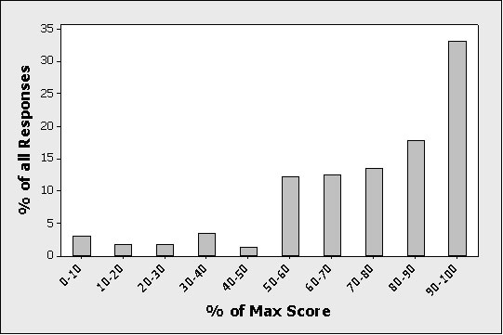
Post Test Analysis of Approx. 3000 Sessions*
Subjective Ease of Use Assessment (when successful)
*Source: Jeff Sauro, Measuring Usability
127

Slide 128
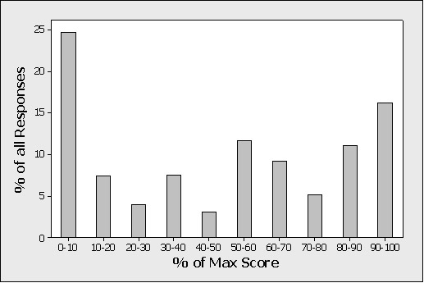
Post Test Analysis of Approx. 3000 Sessions*
Subjective Ease of Use Assessment (when unsuccessful)
128

Slide 129
Effectiveness Data
Effectiveness data can be operationalized in a number of ways but is generally operationalized as success or failure to complete a task
Completion rate as a pass/fail criteria can be measured objectively if the criteria is pre-determined and is not subjective
Best estimates, error rate, and the confidence interval can be calculated easily for pass/fail measure of completion rate using a Binomial calculation
129
User-Centered Design • www.user-centereddesign.com
Notes:
129

Slide 130
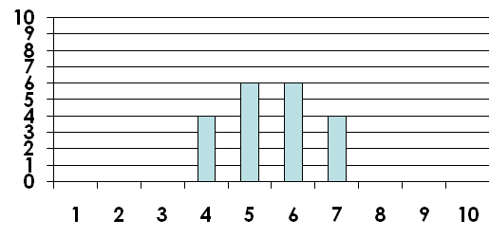
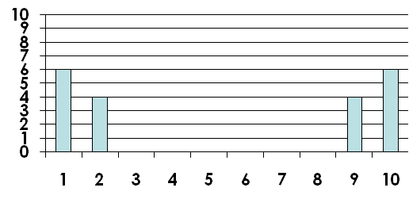
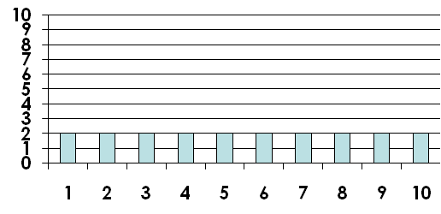
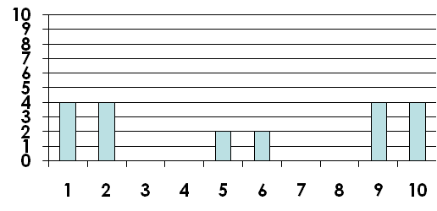
Descriptive Statistics
But the data often shows other patterns such as bimodal distributions. In these cases, the average and standard deviation are not adequate…
130
User-Centered Design • www.user-centereddesign.com
Notes:
130

Slide 131
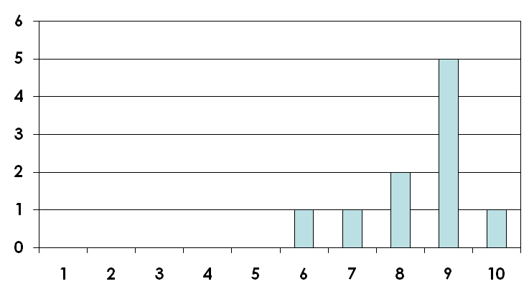
User Ratings
Number who got that score
Score
131
User-Centered Design • www.user-centereddesign.com
Notes:
131

Slide 132
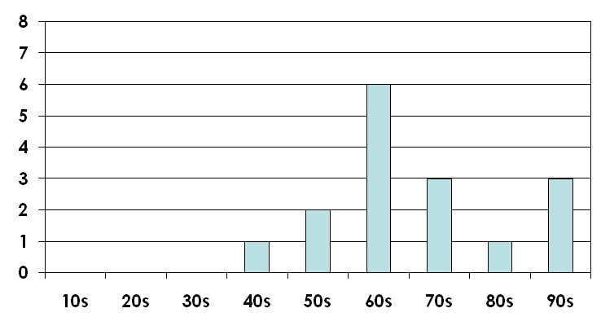
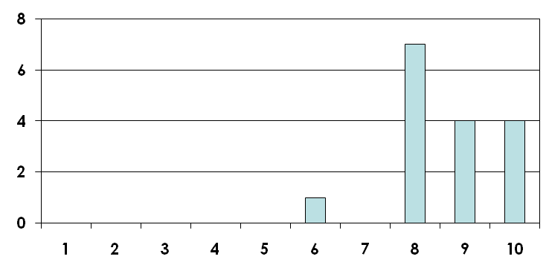
Correlated User Ratings‏
SUS
Cooper Harper
User-Centered Design • www.user-centereddesign.com
Notes:
132

Slide 133
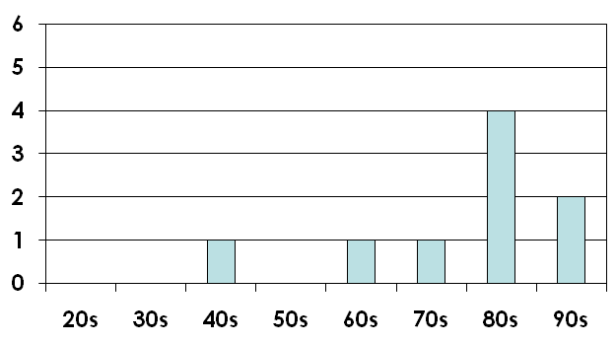
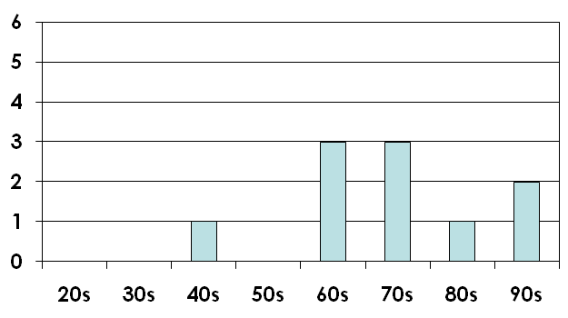
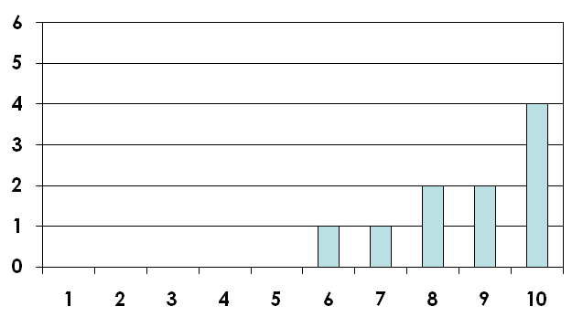
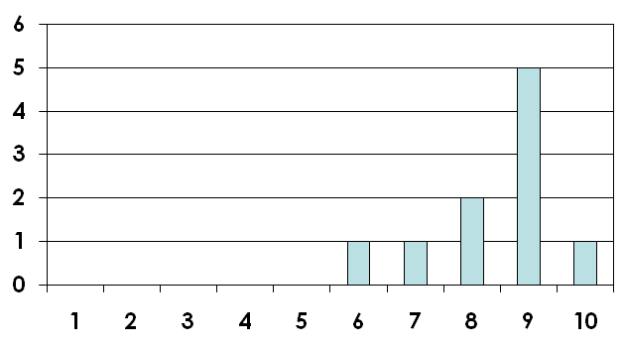
Findings from Sets of User Ratings
Memphis – SUS Data
DC – SUS Data
Memphis – MCH Data
DC – MCH Data
133
User-Centered Design • www.user-centereddesign.com

Slide 134
Reportable “Results”
Violations of industry standards and best practices are reportable results from testing (though many should have been included in any expert review prior to testing)
Direct user comments may or may not be reportable, based on the observers assessment of the comment
Direct user behaviour is generally reportable, but only if confirmed to be behaviour based on a design issue and/or behaviour that is consistent throughout testing
An observation of a reaction suggestive of a cognitive issues, regardless of its effect on observable behaviour, is reportable provided there is a basis for that assumption
Behaviours that did not occur in testing but are suspected to occur under different conditions are reportable provided they re based on prior experience and there is a basis for that behaviour
Subjective data is reportable to support other findings, but this support may be inversely correlated with observation or performance
134
User-Centered Design • www.user-centereddesign.com
Notes:
134

Slide 135
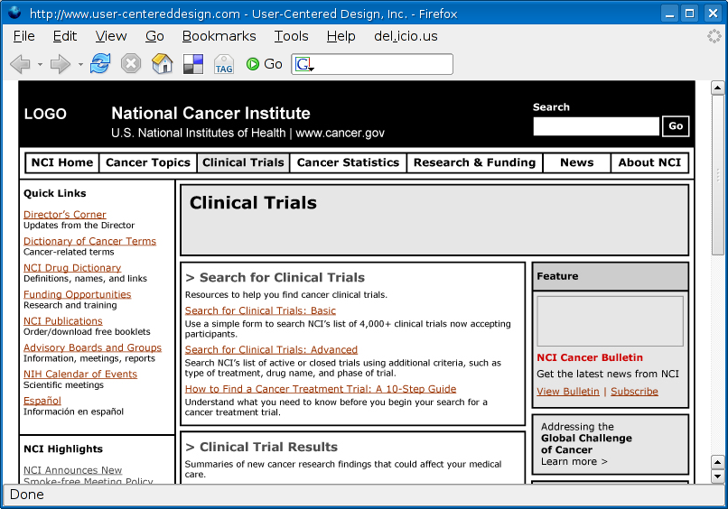
Direct Observation or Comment
Participants had difficulty understanding what content was searched.
Many thought all content in Clinical Trials would be searched, not just ongoing trials
A few participants wanted to use the global NCI search to search Clinical Trials (consider labelling this “Search NCI” or “NCI Search”
Some participants responded to the term “Find” even when the search form was on the page.

Slide 136
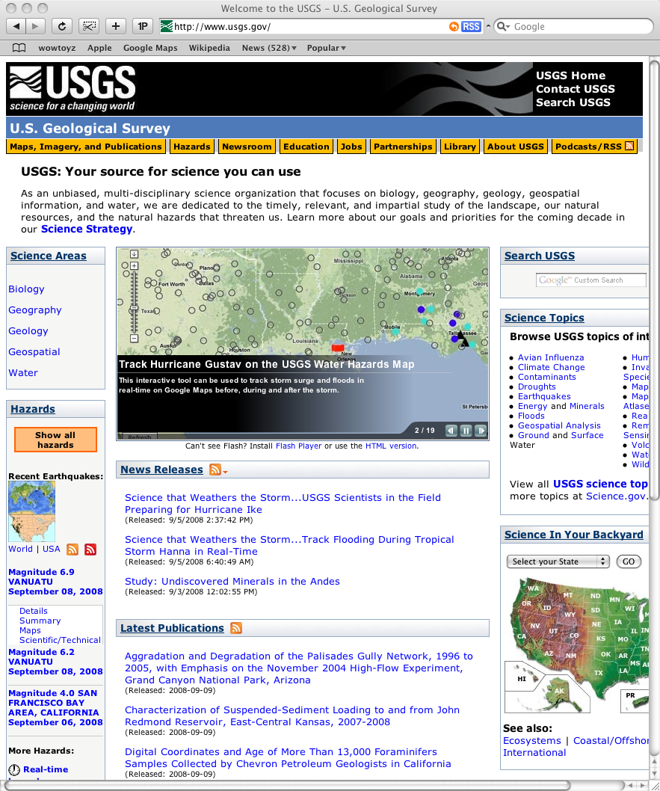
Design Guidelines
All navigation should be in grouped
together.
All navigation should be in grouped
together.

Slide 137
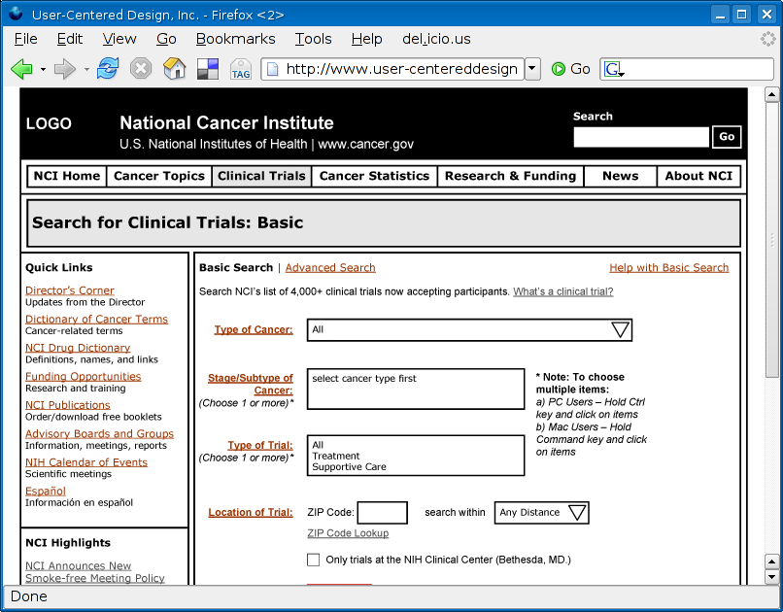
Prior Research Findings
Bold form labels draws users eyes away from the form and reduces usability. Consider removing the bold and possibly bolding the content.

Slide 138
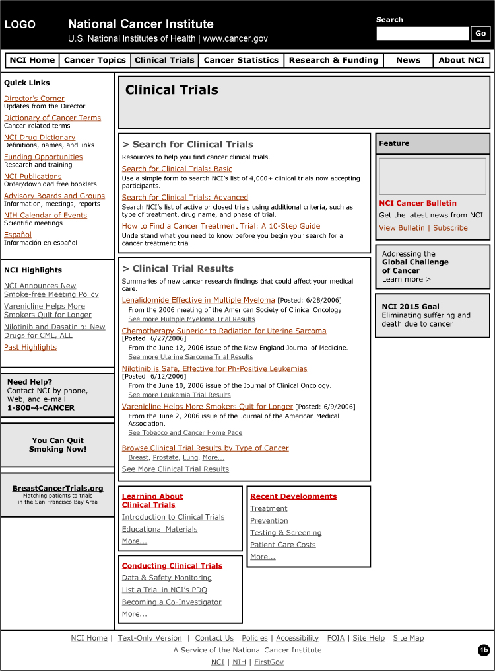
Knowledge of Human Perception:
There are 50
hyper links on the
home page (not including primary nav.) representing four levels within the clinical trial section and direct links to other parts of NCI

Slide 139
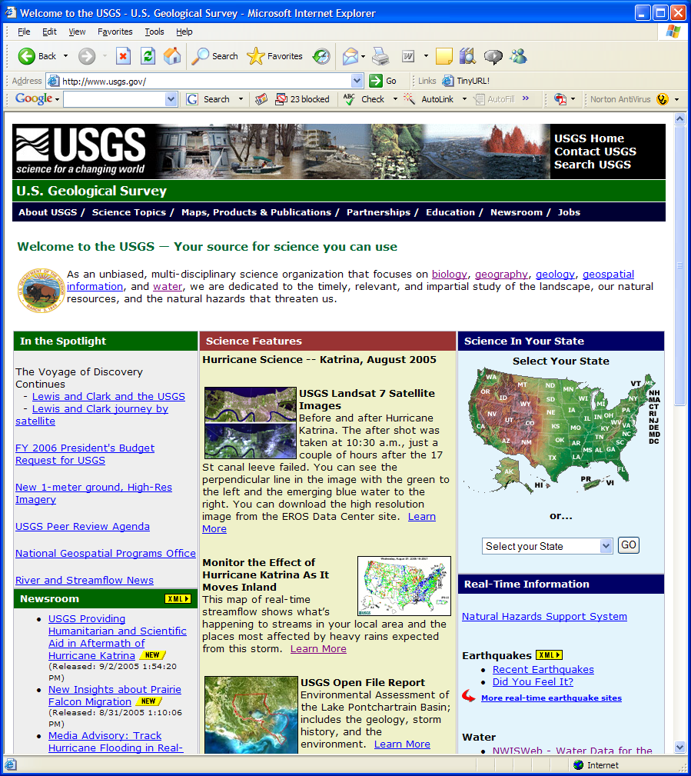
Industry Standards and Best Practices
Participants (without prior exposure) failed to recognized the five primary disciplines as navigational elements. The most common expectation (if noticed at all) was that the links would provide definitions of the terms.
User-Centered Design • www.user-centereddesign.com

Slide 140
Conclusions
Any testing is better than no testing
The more you know about experimental design the better your testing will be, but the more you know about users the better the data you can get from any testing
Unless you have valid and reliable, large sample data available, the is little distinction between a true expert review and user-based testing, but experts need users to “see” the data
140
User-Centered Design • www.user-centereddesign.com
Notes:
140

Slide 141
Conclusions (concluded ;-) )
Testing is best done early and often as part of the design process
The intent of testing should be to not just to know what happened, but to determine why it happened and to figure out what, if anything, can be done about it
Testing with human subject is highly valuable, can be deeply insightful, but is serious business and should not be conducted casually
141
User-Centered Design • www.user-centereddesign.com
Notes:
141

